Slide 1
DATA SCIENCE & RESEARCH PRACTICE Applications & Methods in Data science, and Discussion of Assignment
Instructor: Candice Bradley
TA: Tammy Kihlstadius

Slide 2
Week 2 Overview Analytic Method for Business Processes
Learning Objectives
To Do & Deliverables
Distinguish
Distinguish between refereed and non-refereed sources for researching a paper topic
Use
Use Chicago style for writing a research paper
List
List common data science methods
Define
Define an application in data science for the paper
List and define
List and define the stages toward becoming an analytically competitive organization
Compare and contrast
Compare and contrast internal & external business processes & related analytic techniques
Describe
Describe the AI Factory as a scalable decision factor powered by algorithms
Module 2 Readings and Media (with three required videos at the bottom of the readings and media page)
Module 2 Discussion
Module 2 Quiz (Chicago style)
Begin the Applications & Methods Assignment (Due end of Week 3)

Slide 3

The “applications” concept was defined by Eric Siegel on page 25 of Predictive Analytics: The Power to Predict who will Click, Buy, Lie or Die. Siegel defines an application as any “innovative use of [predictive analytics]” (or any use of data science).
What is an “application” in data science?
Eric Siegel (from his 2022 Twitter page)

Slide 4
Each application is defined by: (Siegel 2016, 25)
“1) What’s predicted: The kind of behavior (i.e. action, event, or happening) to predict for each individual, stock or other kind of element.
“2) What’s done about it: The decisions driven by prediction; the action taken by the organization in response to or informed by each prediction.”

Slide 5
Chapters from Siegel (2016) in the course and on reserve
Chapter 1, plus two sections with lots of topic ideas.
All include the two parts of the applications definition: what’s predicted, and what’s done about it.
You are not limited to those lists.

Slide 6
“What is a Method?”
“What is a Method” is the title of one of this week’s videos. Watch it!
When we talk about methods, we mean, “How do data scientists collect and analyze their data?”
You need at least three data science or predictive analytic methods for your paper.

Slide 7
For the “Applications & Methods” assignment, you will:
Pick an application in data science and write an introduction and review the methods used for this application, along with the contribution of this area to management.
You will include at least three refereed articles as references.
You will include at least three data science methods.
The paper will three double spaced pages in correct Chicago style, Author-Date References method.

Slide 8
Examples in the readings
Netflix Prize example (D&H pp. 21-24): What is the application (what is predicted & what does it do)? What methods are used to get it done? What contributions are made to what area (or areas) of management? (For contributions to areas of management, see the chapters on internal and external processes in Davenport [Ch 4 & 5])
Miller’s Bobblehead example.

Slide 9
Some basics for the Applications assignment:
We use Chicago style (CMOS 17)
Author-Date References version (Ch 15)
Chapters 2 & 15 of CMOS are in course reserves
Chicago style videos linked into week 2
One on citing and referencing
One on formatting your paper
Example paper
Video from Tracy Coyne, librarian, on searching for refereed articles

Slide 10
Refereed article requirements for the “Applications” paper
This paper must have at least three refereed/peer reviewed sources
What is a peer reviewed or refereed journal?
Examples: The Lancet, Journal of the American Medical Association (JAMA), American Anthropologist, Science, Nature.
Some articles in MIT Sloan Management Review and HBR are (but not necessarily all). If NU Library says it’s peer reviewed, I accept it.
A peer-reviewed journal has an editorial board composed of peers (colleagues who are your equals), plus a managing editor.
After a paper is reviewed by several sets of eyes with the freedom to speak their mind, the board will make an informed decision to publish or not, in the spirit of the scientific method.
The process assures a strong commitment to oversight and quality that is not found in any other kind of publication.

Slide 11
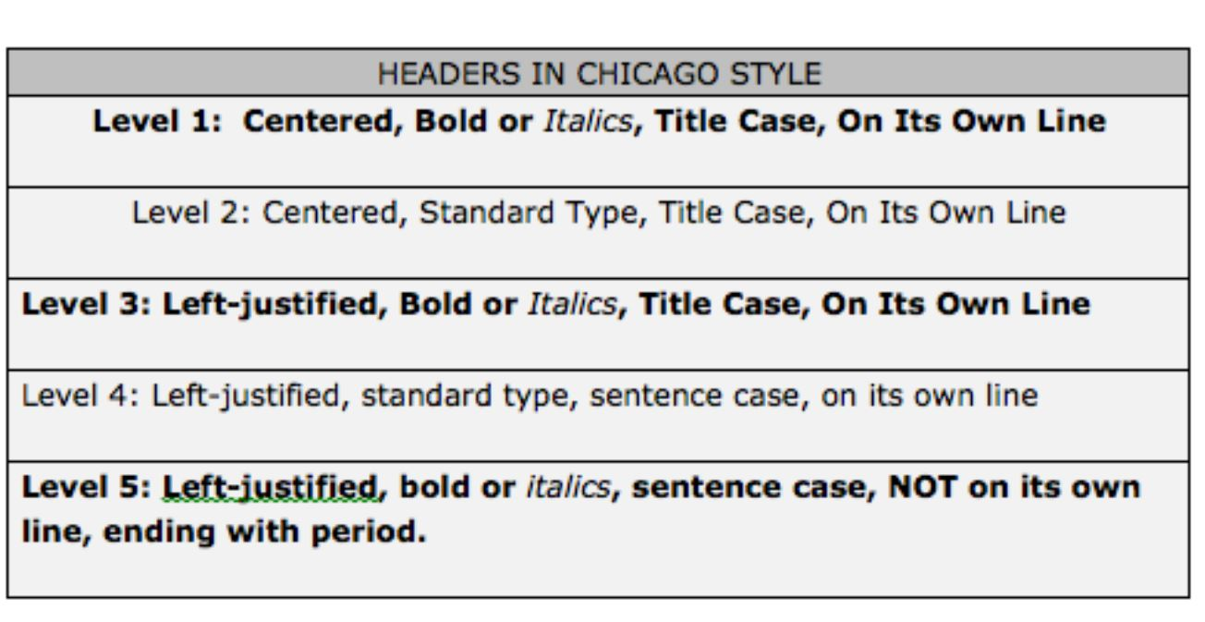
Acceptable headings styles for CMOS 17
These are also acceptable. All are flush left, no bold or italics.
1.0 Section heading
Indented paragraph
2.0 Next section heading
2.1 Subheading 1
2.2 Subheading 2
3.0 Third section heading

Slide 12
Academic Integrity: Turnitin
Applications & Methods paper goes through Turnitin
No special links—just submit through the assignment link
You can submit your paper to the assignment link ahead of time to see your Turnitin score, then resubmit it with corrections before the deadline.
I review all Turnitin reports for high Turnitin scores (>25%), and often look at reports below 25%.
Turnitin will flag quotes. Quoting is not an acceptable way to get around plagiarism. You must put the material into your own words.
A zero Turnitin score is rare. Your references, citations, common headings, etc. will be flagged – that’s where up to 25% will come from – and those are okay.
However, no amount of plagiarism is okay.

Slide 13
If you would like your paper previewed:
Writing Place – make appointment this week to get your paper reviewed next week in time to submit
The Writing Place is the best option if you are unsure of your writing skills in English
Caution – they may not know Author-Date Reference in Chicago style
Your TA (Tammy) no later than a week from Saturday afternoon (preferably earlier).

Slide 14
Next week
Final week of the business analytics unit with readings, discussion, and quiz
Sync session: Searching library for refereed journal articles: demo and individual help during Monday Zoom time.
Applications & Methods paper due end of week 3

